Slide 1
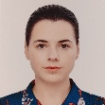
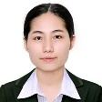
HOV
HOV | Ms. VU THI THUY
Qualification | Bachelor of Education
Kindergarten
Teachers
Integrated
K1/K2
Teacher | Ms. HOANG THI THANH VAN
Qualification | Bachelor of English Preschool Teaching Certificate
Teacher | Ms. JAMIE-LEE DORMEHL
Qualification | Master of Arts – Research Psychology PGCE Foundation Phase
Assistant Teacher | Ms. NGUYEN THI NHUNG
Qualification | Bachelor in Preschool Pedagogy
Teacher | Ms. NGUYEN THU TRANG
Qualification | Bachelor of Arts – English Education
Teacher | Ms. CARMEN BIANCA MARAIS
Qualification | Bachelor of Education, Foundation Phase
Assisteant Teacher | Ms. NGUYEN THI THUY
Qualification | Bachelor of English TEFL
Integrated
Prep

Slide 2
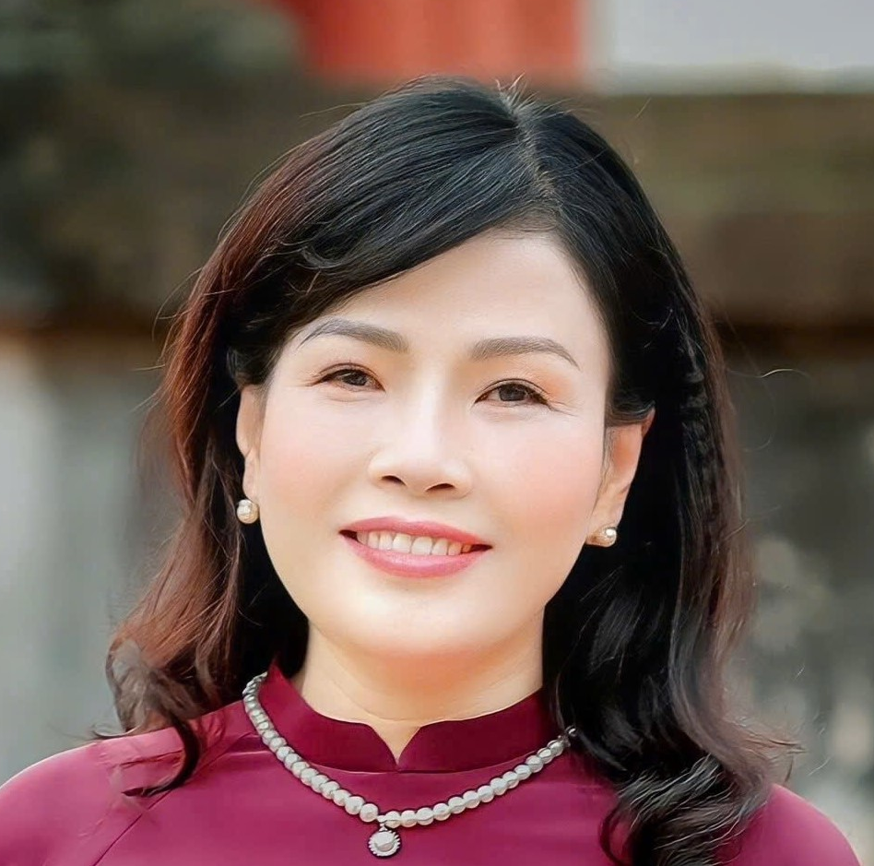
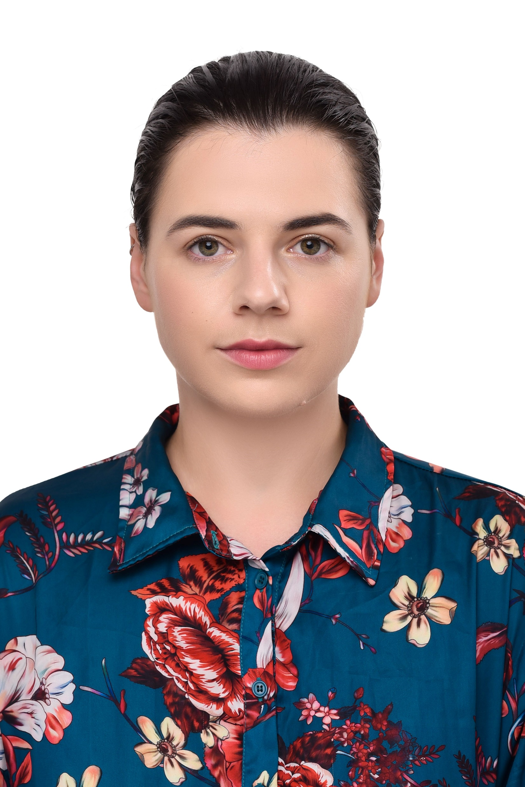
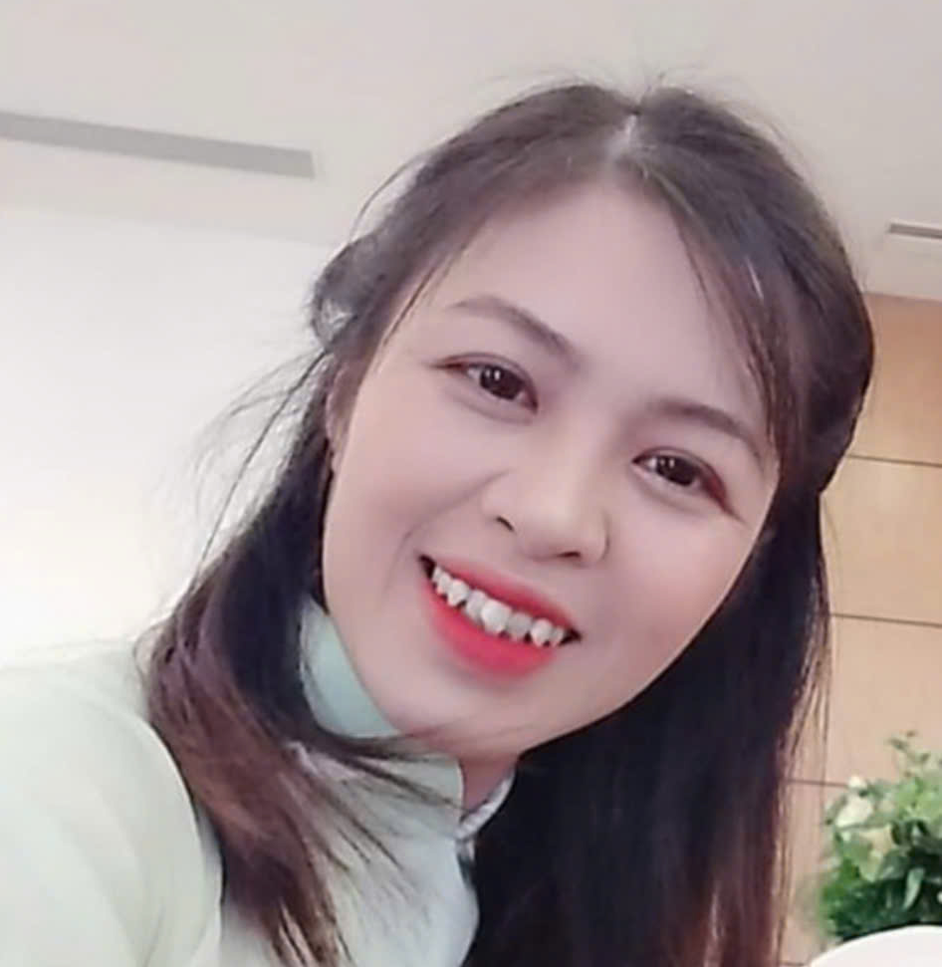
Head of
Vietnamese
HOV | Ms. NGUYEN THI MINH HA
Qualification | Bachelor of Primary Education
Primary
Teachers
Year 1
Integrated
Teacher | Ms. VO NGOC ANH
Qualification | Bachelor of Elementary Education
Teacher | Ms. CARMEN MARAIS
Qualification | Bachelor of Education, Foundation Phase
Class | English, SOSE, Music
Year 2
Integrated
Teacher | Ms. TA THI QUYNH
Qualification | Bachelor of Primary Education
Teacher | Ms. JAMIE-LEE DORMEHL
Qualification | Master of Arts – Research Psychology PGCE Foundation Phase
Class | English, SOSE, Music
Teacher | Ms. NGUYEN QUYNH NGA
Qualification | Bachelor of Elementary Education
Year 3
Integrated
Teacher | Ms. JAMIE-LEE DORMEHL
Qualification | Master of Arts – Research Psychology PGCE Foundation Phase
Class | English

Slide 3
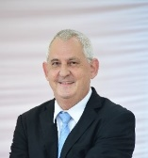
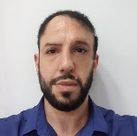
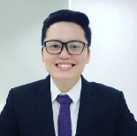
Head
Teacher
Head Teacher | Mr. MARK WATLING
Qualification | Bachelor of Education, TEFL
Teacher | Ms. CARMEN MARAIS
Qualification | Bachelor of Education – Foundation Phase
Class | KIK, Primary
Music
Teaches
Other
Specialist
Teachers
Teacher | Mr. YASSINE BADER
Qualification | Bachelor of Science, Sports Coaching and Conditioning PGCEi
Class | KIK, Primary
Physical
Education
Teacher
Teacher | Mr. NGUYEN PHU
Qualification | Bachelor of Chinese Education Masters of Public Affairs Management
Class | Primary
Chinese
Language
Teaches
ICT
Teacher
Teacher | Mr. MARK WATLING
Qualification | Bachelor of Education, TEFL
Class | Primary and Prep

